Slide 1
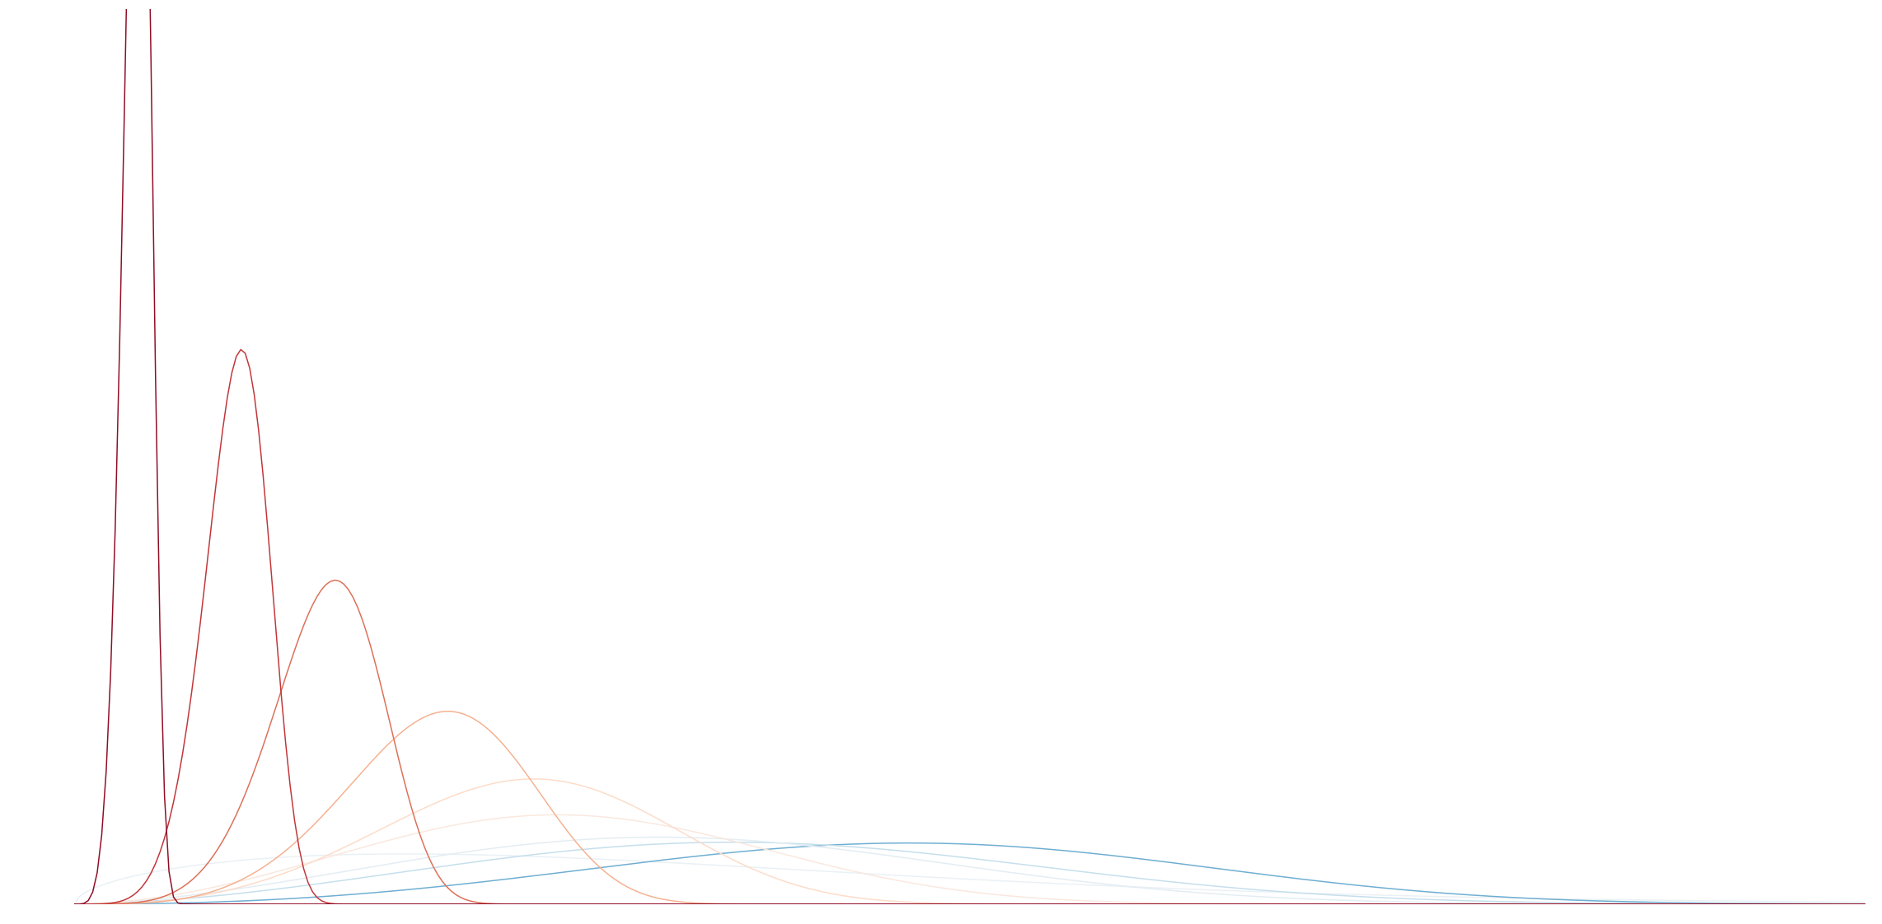
RNN -
Time To Event
Using Recurrent Neural Networks to predict the time to an event
Manel Maragall

Slide 2
The Time to an Event is the primary outcome of interest in many fields

Slide 3
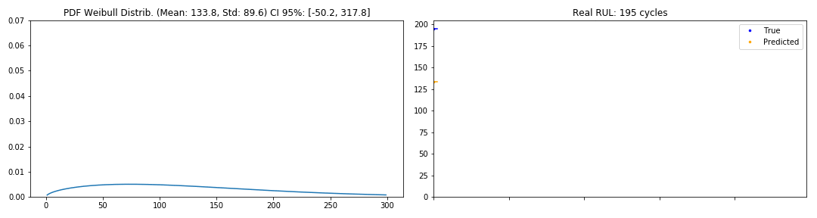
The Time To Failure
Positively skewed
Subject to censoring
Usually long sequences explained by time varying variables
Useful for Predictive Maintenance in the Pharmaceutical Industry
Statisticians have been studying it for a long time
Notes:
e.g., medical research, customer churn, etc.
Therefore conventional statistical learning techniques don’t work

Slide 4
What if we use Recurrent Neural Networks to predict an statistic distribution?

Slide 5
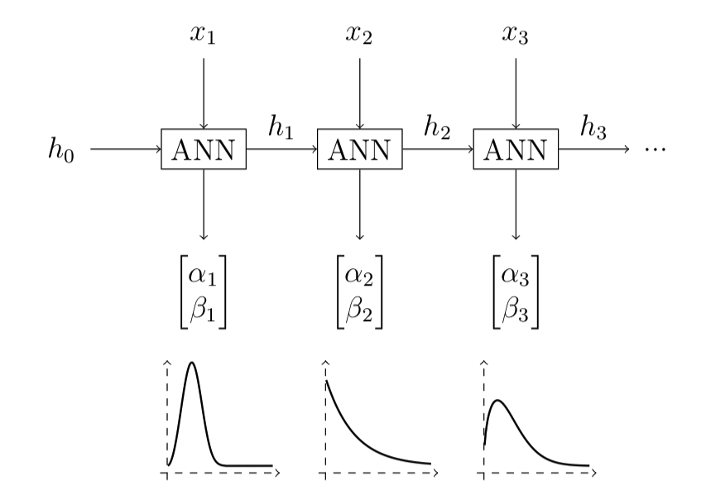

WTTE-RNN
Use Recurrent Neural Networks to predict the shape and scale of the Weibull Distribution
Notes:
Why the Weibull Distribution?
We get a measure of uncertainty! Very interesting for the context

Slide 6
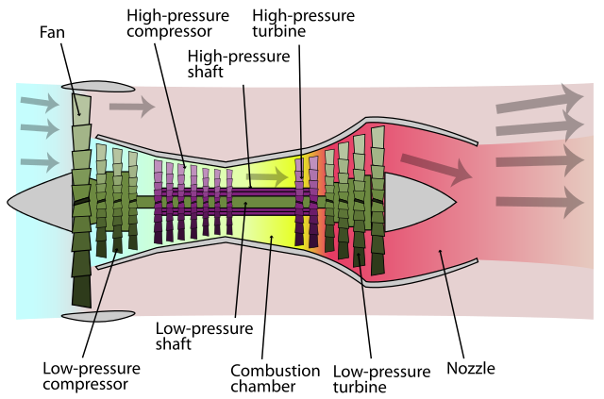
Turbofan Engine
Dataset
Simulated with C-MAPSS at NASA
6 operating conditions
2 failure modes
Original training set (100) is split into train (80) and validation (20)
Engines in train are monitored from the start (normal) to the end (failure)
Test sequences (100) are censored
26 variables
Notes:
Why? There are no datasets
Stands for Commercial Modular Aero-Propulsion System Simula-
tion, and it is a tool for the simulation of realistic large commercial turbofan engine
Data.
The 2 failure modes correspond to the fan degradation and the
high-pressure compressor degradation (check Figure 4.1), whereas the 6 operating
conditions are a combination of altitude, flight speed and TRA.

Slide 7
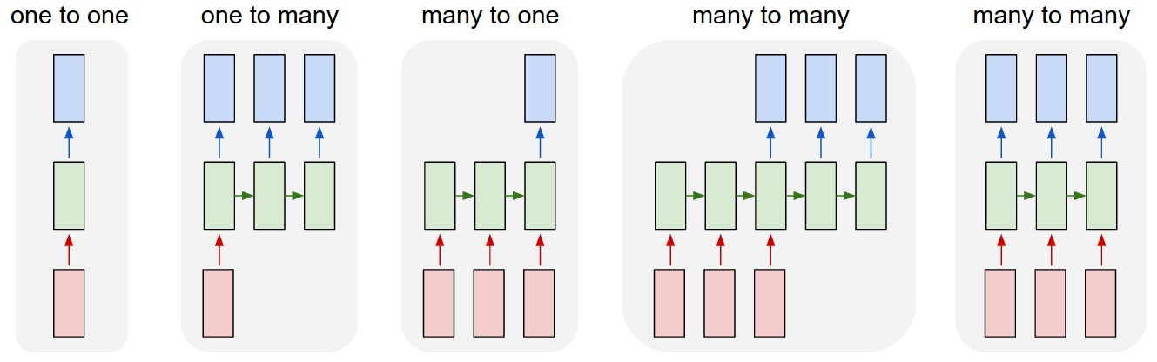
Two ways to model the problem
Rolling Window
Split in sequences of “lookback period”
Return the output state of the last unit
Sequences are independent
Batch Mode
Organize the data in batches
Return the output of all the units
State is preserved
Easy to shuffle
Notes:
Batch Mode after talking with Martinsson

Slide 8
Baseline
Masking
LSTM 100
Batch Mode
Right Padding
Recurrent Dropout of 20%
Early Stopping of 30 epochs
Shuffle batches
Exponential activation function
LSTM 50
Time Distributed

Slide 9
Adapting to WTTE-RNN
Discrete log-likelihood loss
Exponential activation for the scale parameter
Sigmoid activation for the shape parameter
Initialize scale parameter
Gradient clipping
Scale factor in GRU variant

Slide 10
95%
Of the failures from the validation set can be warned with an anticipation between 40 and 60 cycles just by triggering an alarm when the standard deviation is below 10 cycles.

Slide 11
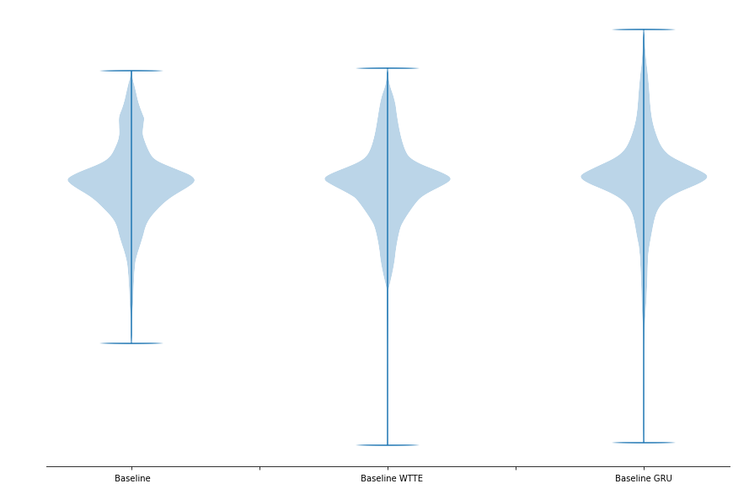
MAE
RMSE
R^2
17.4
24.0
0.87
17.8
25.3
0.85
18.3
27.5
0.82

Slide 12
The WTTE-RNN model is just as good as the regressor, but it has many interesting attributes for Predictive Maintenance
Notes:
Future work

Slide 13



Thanks! manelmc13@gmail.com
@manelmc
@manelmc1

